Slide 1

Empowering Users with Self-Service Reporting Solution
…Implementation and Success Story
Presented by: Nkemjika Nwanebu

Slide 2
Agenda
Introduction
Overview of self-service reporting
Implementing self-service solution

Slide 3

Overview of Self-service Reporting
Implementing and adopting self-reporting solutions.
What is self-service reporting solution?
Challenges in accessing information
Importance of self-service reporting
How would I approach business readiness?

Slide 4

What is Self-Service Reporting
The Concept of self-service reporting
Define Self-service reporting
Types of self-service reporting

Slide 5
The Importance of Self-Service Reporting
Enhances agility and efficiency
Empowers users to make data-driven decisions
Reduces dependency on IT resources

Slide 6
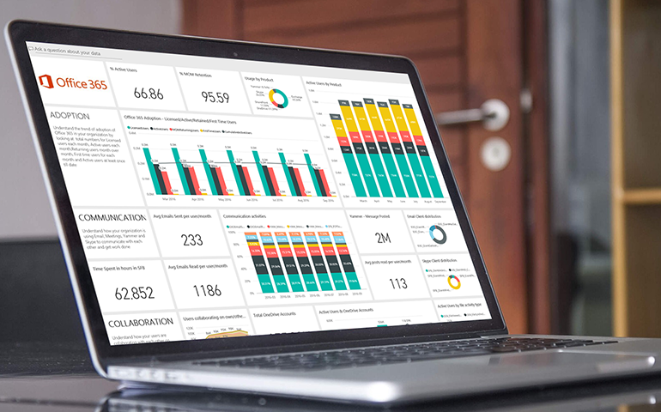
Accessing Self-Service Reports
Reporting Portals
Web or mobile applications
Microsoft Power Apps
Application Programming Interfaces (API)
Other ETL solutions

Slide 7

Addressing Challenges in Accessing Information
Limited accessibility to timely and relevant data
Dependency on IT for report generation
Inefficient decision-making processes due to data silos

Slide 8

Business Readiness
Assessing Data Maturity Level
Get buy-ins of top Executive Management
User Requirement
Infrastructure & Tools requirements

Slide 9

Assessing Data Maturity
Evaluate
Evaluate existing data infrastructure
Identify
Identify gaps in data governance and accessibility
Determine
Determine user proficiency with reporting tools
Notes:
9

Slide 10
User Experience
Central hub for accessing reports and analytics
Customizable dashboards for different user roles
Self-service capabilities for ad-hoc querying and analysis
Integration with existing systems for seamless data flow

Slide 11
Steps to Adopt Self-Service Reporting
Assess Current Reporting Infrastructure
Define User Requirements
Select and Implement Self-Service Reporting Platform
Establish Data Governance Policies (DSPToolkit & Safeguard)
Promote User Adoption

Slide 12

My Role
Provide leadership to the team
Expertise in data management and analysis
Champion the transition to self-service reporting
Collaborate with IT and business units to define requirements
Provide training and support for users
Ensure data integrity and security

Slide 13
Lessons Learned
What Has Worked Well
What Hasn't Worked Well
Establishing clear communication channels
Providing comprehensive training programs
Fostering a culture of data literacy
Lack of user adoption due to complexity
Insufficient data governance leading to inconsistent reports
Resistance to change from some stakeholders

Slide 14



Conclusion
Data is important to drive decision making
Ease of accessing data through self-service portals to reduce over-dependence on limited resources.
Need for a data leader to drive implementation and adoption of use.
Notes:
14

Slide 15

Thank you for having me today!
Notes:
15

Slide 16

Q&A

